Slide 1
Mirror database (eDate)

Slide 2
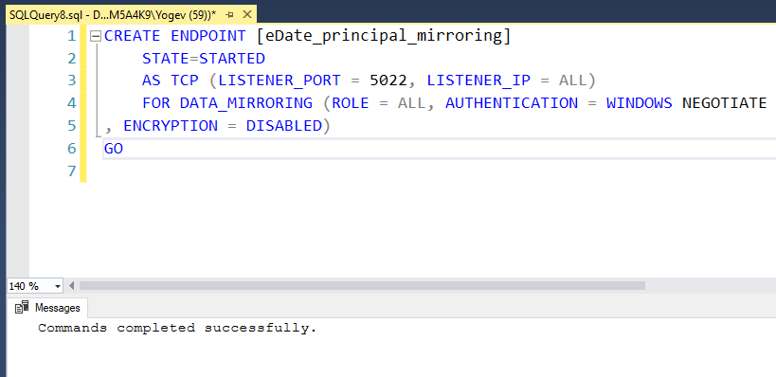
Create endpoint on the principal instance

Slide 3
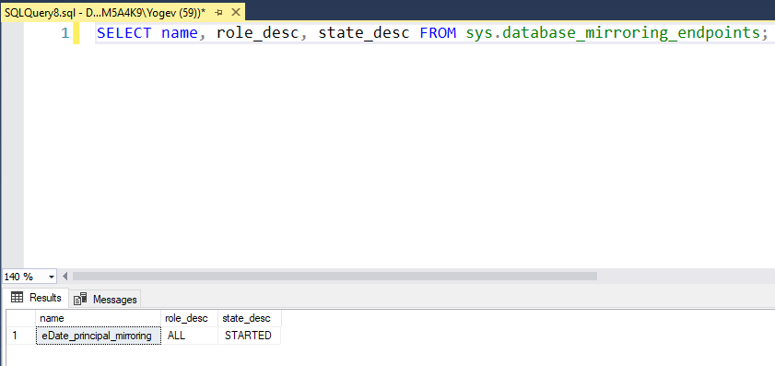

Slide 4
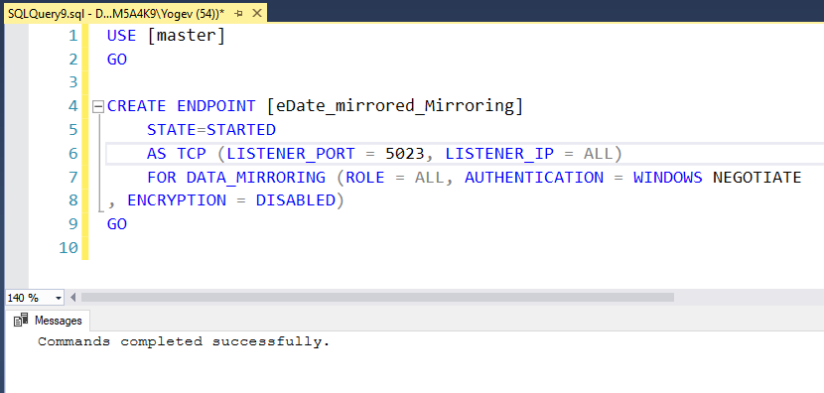
Create endpoint on the mirrored instance

Slide 5
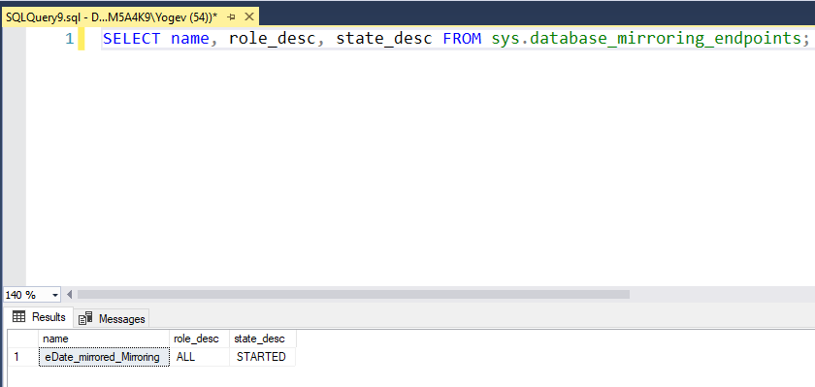

Slide 6
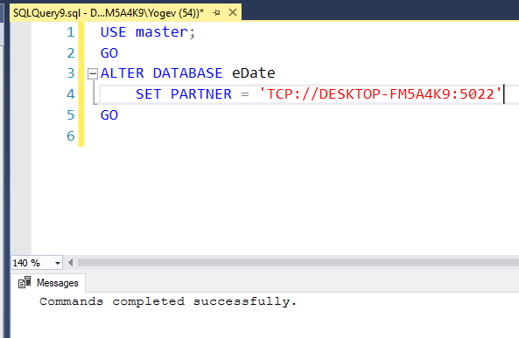
Set the mirror on the mirror instance

Slide 7
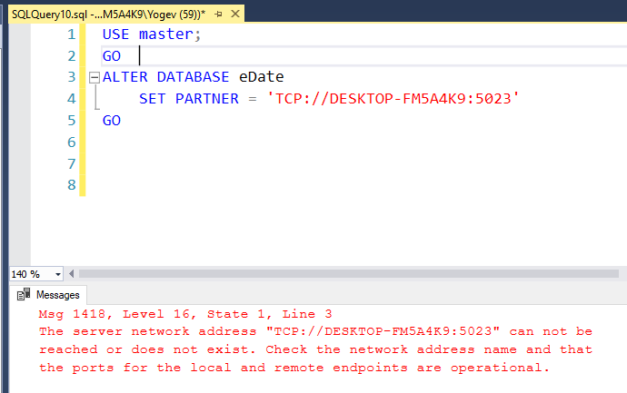
Set the mirror on the principal instance
I can’t seem to handle the 1418 error on the principal instance with port 2023

